Slide 1
Testing proportions: Binomial and Chi-squared
bio5312 Fall2017
stephanie j. spielman, PhD

Slide 2
Hypothesis testing frameworks
t-tests compare means for continuous quantitative data
Today we will learn to analyze discrete count data ("proportions"):
Binomial test
𝝌² goodness-of-fit
Contingency table analysis
𝝌² association/homogeneity and Fisher exact test
Odds ratios

Slide 3
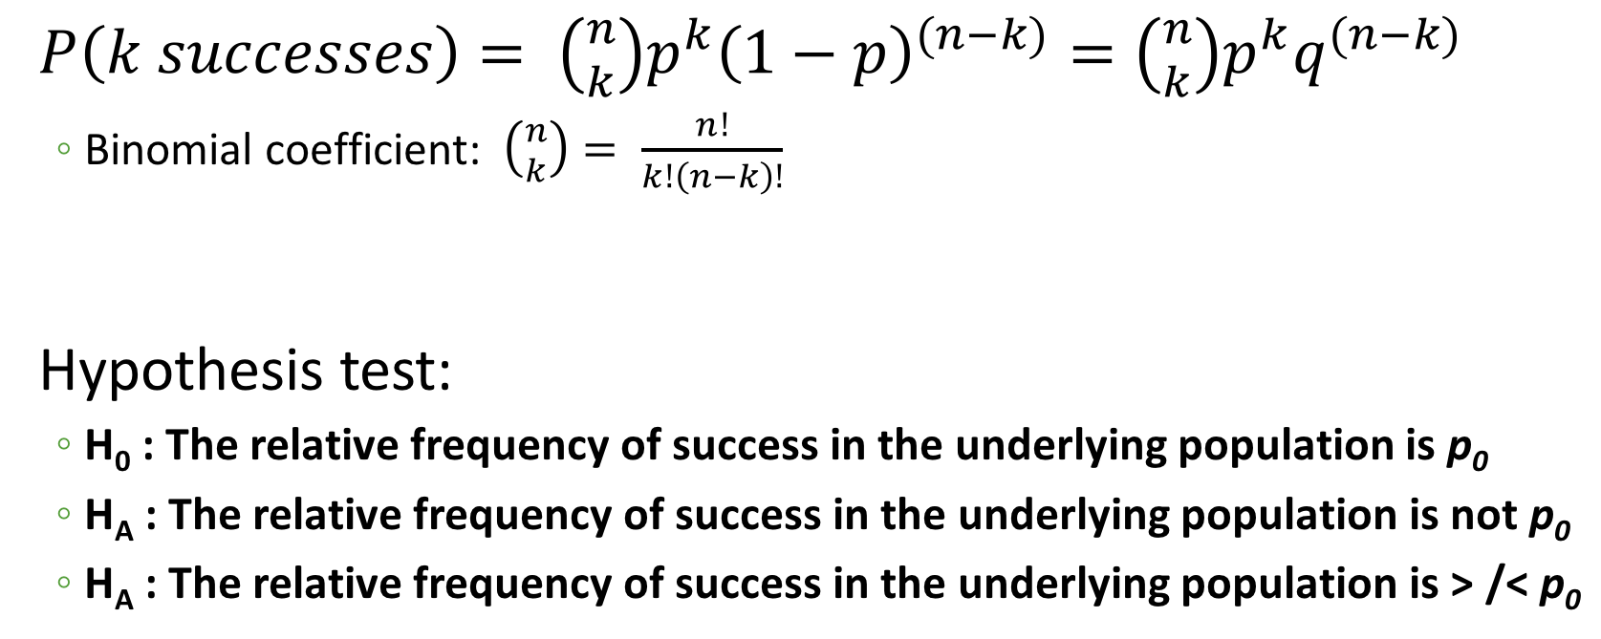
Binomial test
$P\left(k successes\right)= \left({n \atop k}\right)p^{k}{\left(1−p\right)}^{(n−k)}=\left({n \atop k}\right)p^{k}q^{(n−k)}$
Binomial coefficient: $\left({n \atop k}\right)= \frac{n!}{k!\left(n−k\right)!}$
Hypothesis test:
H₀ : The relative frequency of success in the underlying population is p₀
H_{A} : The relative frequency of success in the underlying population is not p₀
H_{A} : The relative frequency of success in the underlying population is > /< p₀
Null proportion of successes to test against

Slide 4
Binomial test assumption: BInS conditions are satisfied
Binary outcomes
Independent trials (outcomes do not influence each other)
n is fixed before the trials begin
Same probability of success, p, for all trials

Slide 5
Binomial test: Example
In a certain species of wasp, each wasp has a 20% chance of being male. I collect 12 wasps, of which 5 are male. Does my sample show evidence that 30% of wasps are male? Use α=0.05.
In other words, is the observed success proportion 5/12 (41.67%) consistent with a population whose probability of success is 0.3?

Slide 6
Verifying assumptions
Binary outcomes: Male or female
Independent trials: Wasp sex does not influence sex of other wasps
n is fixed before the trials begin: I collect 12 wasps
Same probability of success, p, for all trials: P(male) = 0.3 for every wasp

Slide 7
Performing the binomial test
My sample:
p = 5/12 = 0.417
n = 12
X = 5
We generally say X instead of k when performing hypothesis tests, by convention
H₀ : The probability of being a male wasp is p₀ = 0.3
H_{A}: The probability of being a male wasp differs from p₀ = 0.3

Slide 8
The PMF for wasp sex
This is the null distribution!

Slide 9
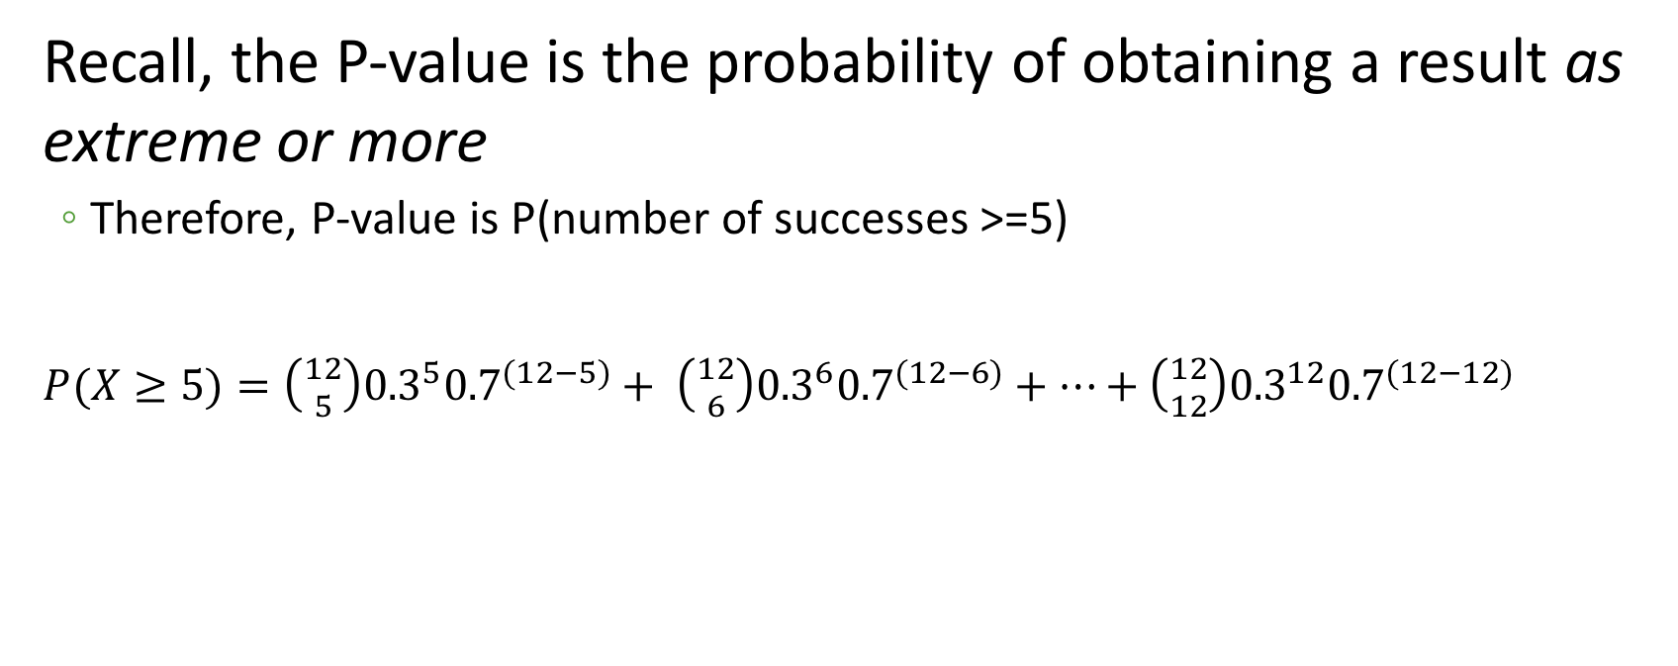
Performing the test
p₀ = 0.3
n = 12
X = 5
Recall, the P-value is the probability of obtaining a result as extreme or more
Therefore, P-value is P(number of successes >=5)
$P(X≥5)=\left({12 \atop 5}\right){0.3}^{5}{0.7}^{(12−5)}+ \left({12 \atop 6}\right){0.3}^{6}{0.7}^{(12−6)}+…+\left({12 \atop 12}\right){0.3}^{12}{0.7}^{(12−12)}$
> 1 – pbinom(4, 12, 0.3)
[1] 0.2673445

Slide 10
Conclusions
Our P-value of 0.276 is much greater than α. Therefore we fail to reject the null hypothesis and we have no evidence that the population proportion of males corresponding to our sample differs from 0.3.

Slide 11
Notes on binomial tests
Computing two-sided P-values is non-trivial
Binomial distribution symmetric only when p=0.5
> binom.test(5, 12, 0.3)
Exact binomial test
data: 5 and 12
number of successes = 5, number of trials = 12, p-value = 0.3614
alternative hypothesis: true probability of success is not equal to 0.3
95 percent confidence interval:
0.1516522 0.7233303
sample estimates:
probability of success
0.4166667
This is not 0.276*2!

Slide 12
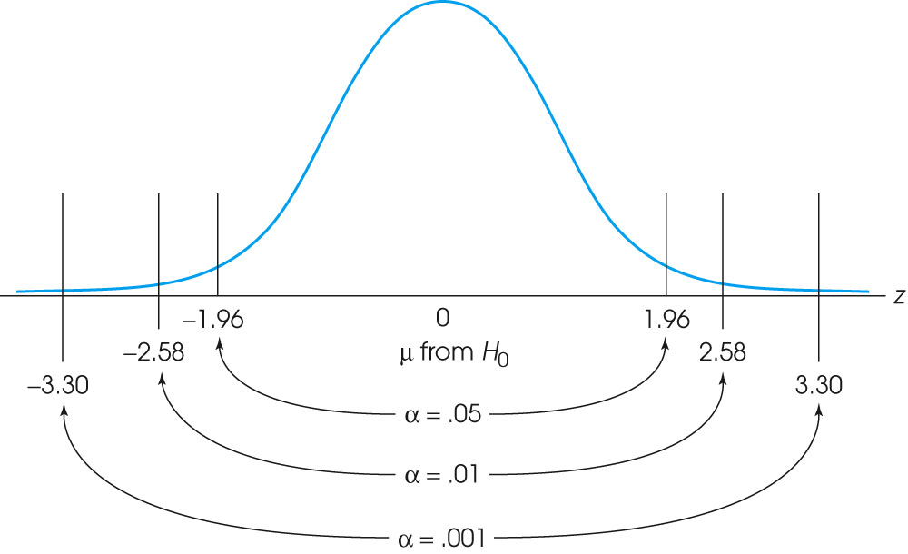
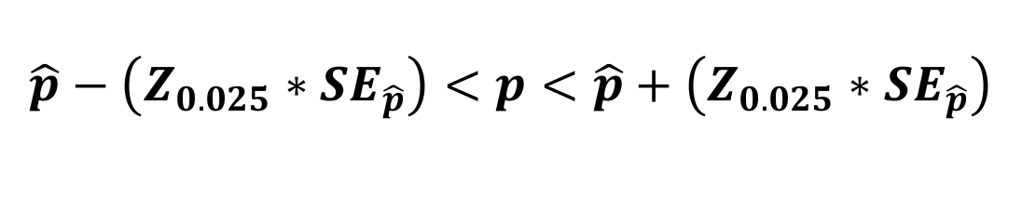
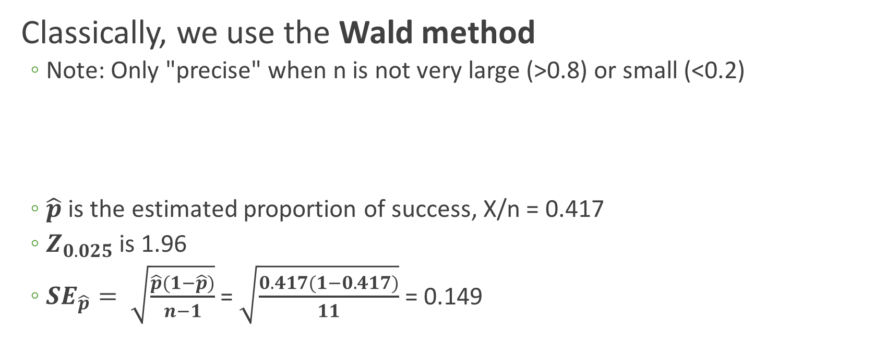
Computing the binomial confidence interval
Classically, we use the Wald method
Note: Only "precise" when n is not very large (>0.8) or small (<0.2)
$\hat{p}$ is the estimated proportion of success, X/n = 0.417
$Z_{0.025}$ is 1.96
${SE}_{\hat{p}}= \sqrt{\frac{\hat{p}(1−\hat{p})}{n−1}}$ = $\sqrt{\frac{0.417(1−0.417)}{11}}$ = 0.149
$$\hat{p}−\left(Z_{0.025}∗{SE}_{\hat{p}}\right)<p<\hat{p}+\left(Z_{0.025}∗{SE}_{\hat{p}}\right)$$

Slide 13
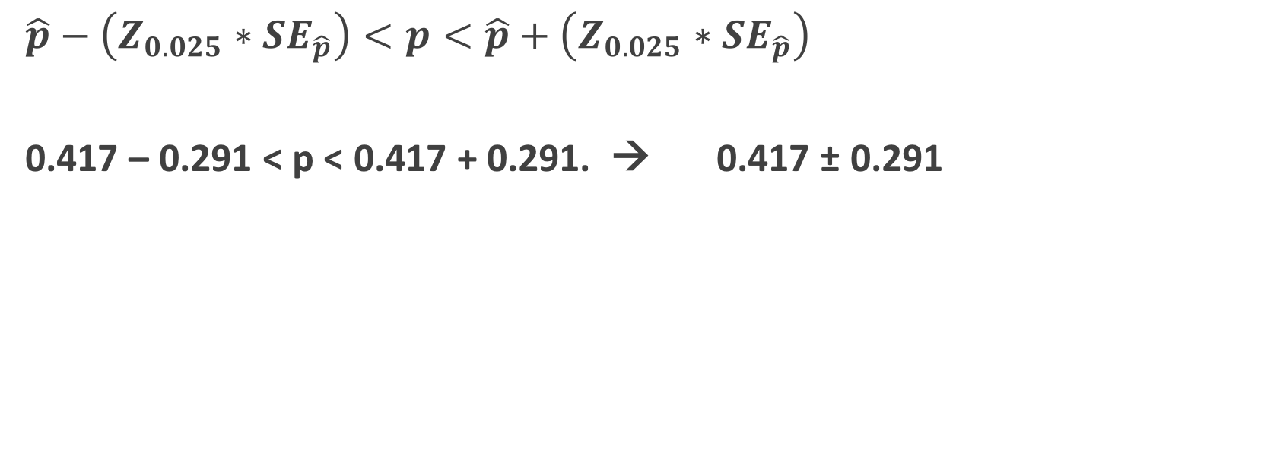
Our CI
$$\hat{p}−\left(Z_{0.025}∗{SE}_{\hat{p}}\right)<p<\hat{p}+\left(Z_{0.025}∗{SE}_{\hat{p}}\right)$$
0.417 – 0.291 < p < 0.417 + 0.291. → 0.417 ± 0.291
> binom.test(5, 12, 0.3)
Exact binomial test
data: 5 and 12
number of successes = 5, number of trials = 12, p-value = 0.3614
alternative hypothesis: true probability of success is not equal to 0.3
95 percent confidence interval:
0.1516522 0.7233303
sample estimates:
probability of success
0.4166667
R uses a more exact method, the Clopper-Pearson interval

Slide 14
Another binomial example
A study wanted to test whether 25 genes known to involved in spermatogensis occurred disproportionally on the X-chromosome. 40% of these genes were on the X chromosome, which contains 6.1% of all genes.
Do we have evidence that spermatogenesis genes are more likely to be on the X chromosome?
p₀ = 0.061
n = 25
X = 0.4 * 25 = 10

Slide 15
Hypotheses (one-sided)
H₀ : The probability that a spermatogenesis gene is on the X chromosome is p₀ = 0.061
H_{A}: The probability that a spermatogenesis gene is on the X chromosome is greater than the null p₀ = 0.061

Slide 16
Perform the test and report findings
> binom.test(10, 25, p=0.061)
Exact binomial test
data: 10 and 25
number of successes = 10, number of trials = 25, p-value = 9.94e-07
alternative hypothesis: true probability of success is not equal to 0.061
95 percent confidence interval:
0.2112548 0.6133465
sample estimates:
probability of success
0.4
With P-value of 9.9e-7, we reject the null hypothesis and we have evidence that spermatogenesis genes are more frequent on the X chromosome, with an estimated probability of p=0.4. Our 95% CI is [0.21, 0.61].

Slide 17
What if we do not have binary outcomes?
Goodness-of-fit tests ask if observed proportions are equal to a null proportion
If my counts are distributed 35:40:38, do they comply with a null 1:1:1?
Chi-squared
G-test

Slide 18
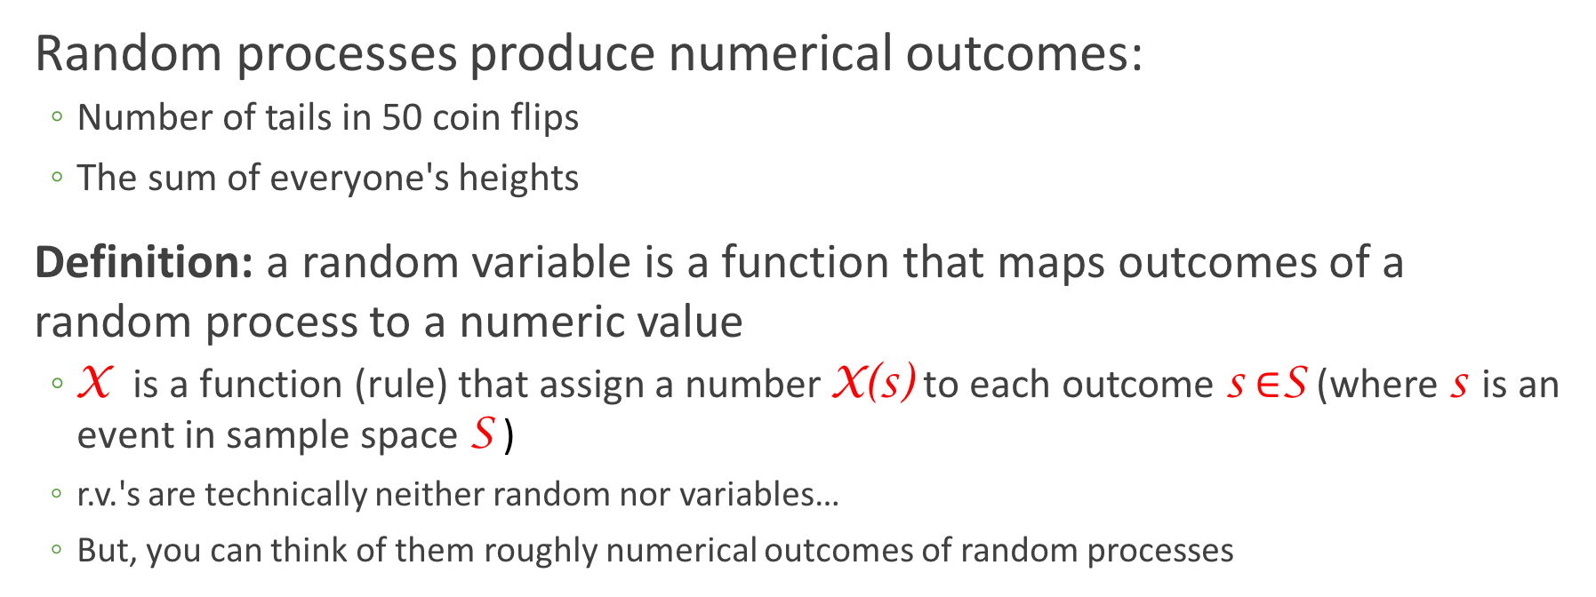
Random variable
Random processes produce numerical outcomes:
Number of tails in 50 coin flips
The sum of everyone's heights
Definition: a random variable is a function that maps outcomes of a random process to a numeric value
X is a function (rule) that assign a number X(s) to each outcome s $∈$S (where s is an event in sample space S )
r.v.'s are technically neither random nor variables…
But, you can think of them roughly numerical outcomes of random processes

Slide 19
Discrete vs continuous RV
Discrete random variables can take on (map to) a finite number of values
Continuous random variables can take on (map to) innumerable/infinite values

Slide 20
Expressing discrete random variables
Probability mass function (PMF)
Describes the values taken by a discrete r.v. X and its associated probabilities
Function that assigns, to any possible value x of a discrete r.v. X, the probability P(X = x)
PMF for rolling a fair die
P(X = x)
x

Slide 21
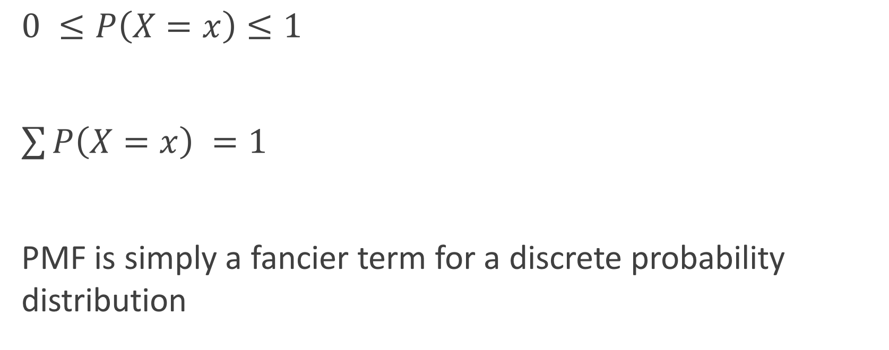
PMF properties
$0 ≤P\left(X=x\right)≤1$
$\sum{P\left(X=x\right) =1}$
PMF is simply a fancier term for a discrete probability distribution

Slide 22
Expressing discrete random variables
Cumulative distribution function (CDF)
Function defined, for a specific value x of a discrete r.v. X, as F(x) = P(X ≤ x)
CDF for rolling a fair die
P(X ≤ 4)
P(X ≤ 1)

Slide 23
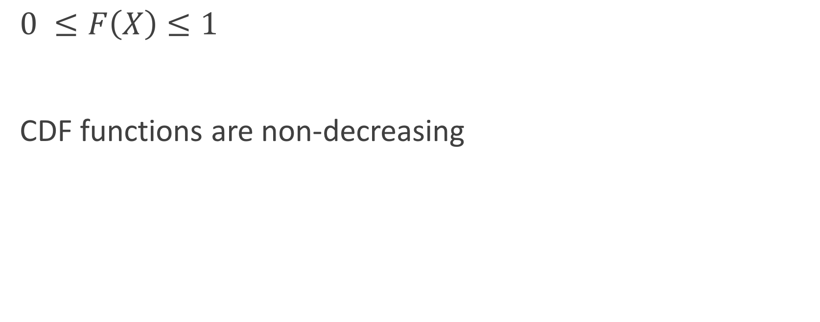
CDF properties
$0 ≤F\left(X\right)≤1$
CDF functions are non-decreasing

Slide 24
PMF vs CDF
PMF: What is the probability of event X?
CDF: What is the sum of probabilities for all events ≤ X?

Slide 25
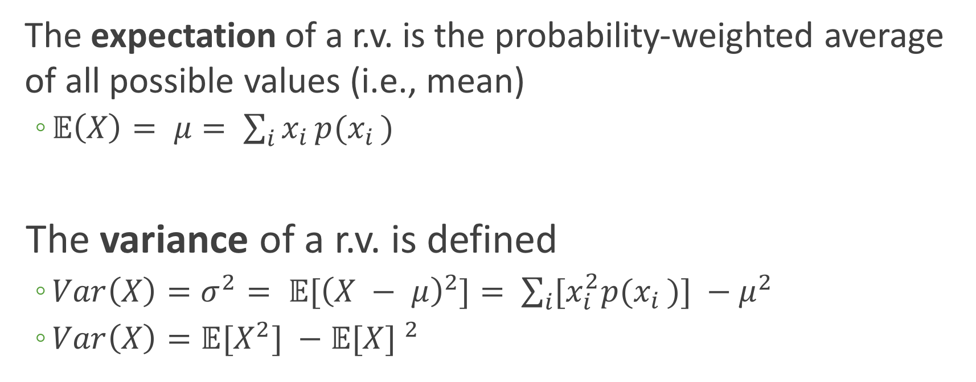
Expectation and spread of random variables
The expectation of a r.v. is the probability-weighted average of all possible values (i.e., mean)
$𝔼\left(X\right)= μ= \sum_{i}{x_{i }{p(x}_{i })}$
The variance of a r.v. is defined
$Var\left(X\right)=σ^{2}= 𝔼{[\left(X − μ\right)}^{2}]= \sum_{i}{[x_{i}^{2}{p(x}_{i })}] −μ^{2}$
$Var\left(X\right)=𝔼{[X}^{2}] −{𝔼[X] }^{2}$

Slide 26
Example: The Binomial distribution
The binomial distribution describes the probability of obtaining k successes in n Bernoulli trials, where the probability of success for each trial is constant at p
A Bernoulli trial has a binary outcome (success/fail, true/false, yes/no), and P(success) = p is the same for all realizations of the trial

Slide 27
The BInS conditions
To be binomially distributed, must satisfy the following:
Binary outcomes
Independent trials (outcomes do not influence each other)
n is fixed before the trials begin
Same probability of success, p, for all trials

Slide 28
Is it binomial?
A bag contains 10 balls, 7 red and 3 green.
Situation 1: You draw 5 balls from the bag, noting the ball color each time and then returning it to the bag.
Situation 2: You draw 5 balls from the bag, retaining each drawn ball for safe-keeping so you can play catch at any moment.
Situation 3: You keep drawing balls, with replacement, until you have drawn 4 red balls.
Yes!
No ☹
No ☹

Slide 29
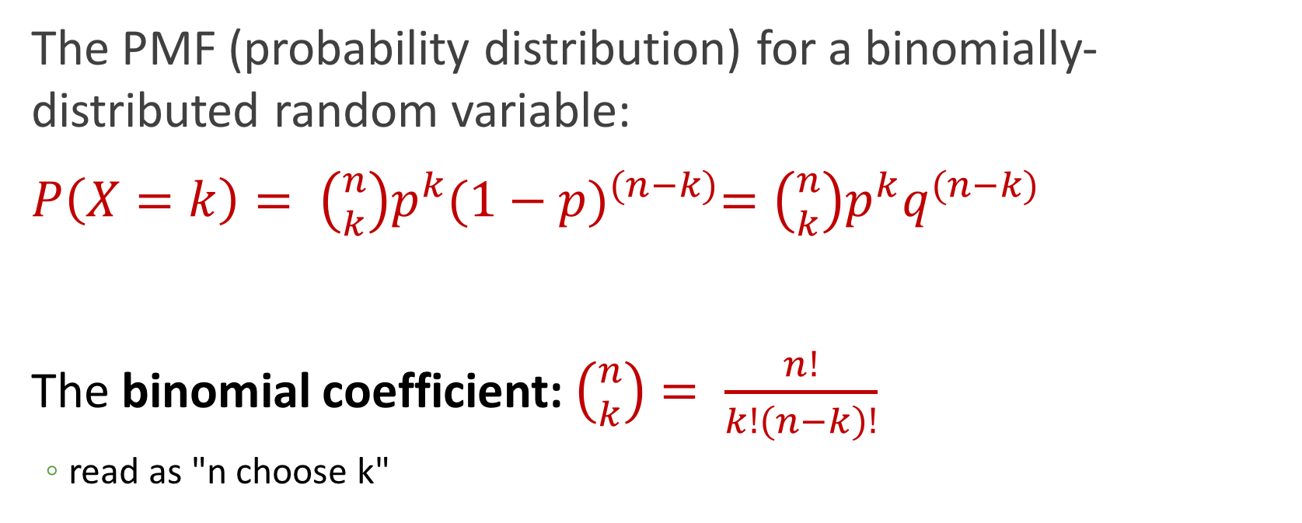
The binomial distribution
The PMF (probability distribution) for a binomially-distributed random variable:
$P\left(X=k\right)= \left({n \atop k}\right)p^{k}{(1−p)}^{(n−k)}=\left({n \atop k}\right)p^{k}q^{(n−k)}$
The binomial coefficient: $\left({n \atop k}\right)= \frac{n!}{k!\left(n−k\right)!}$
read as "n choose k"

Slide 30
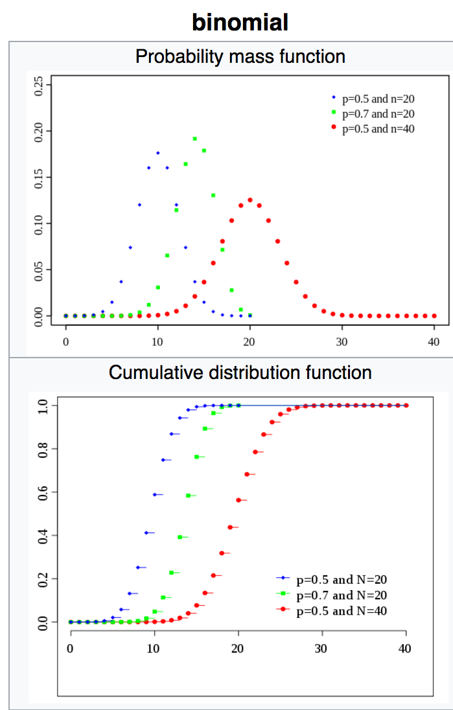
Wikipedia weighs in

Slide 31
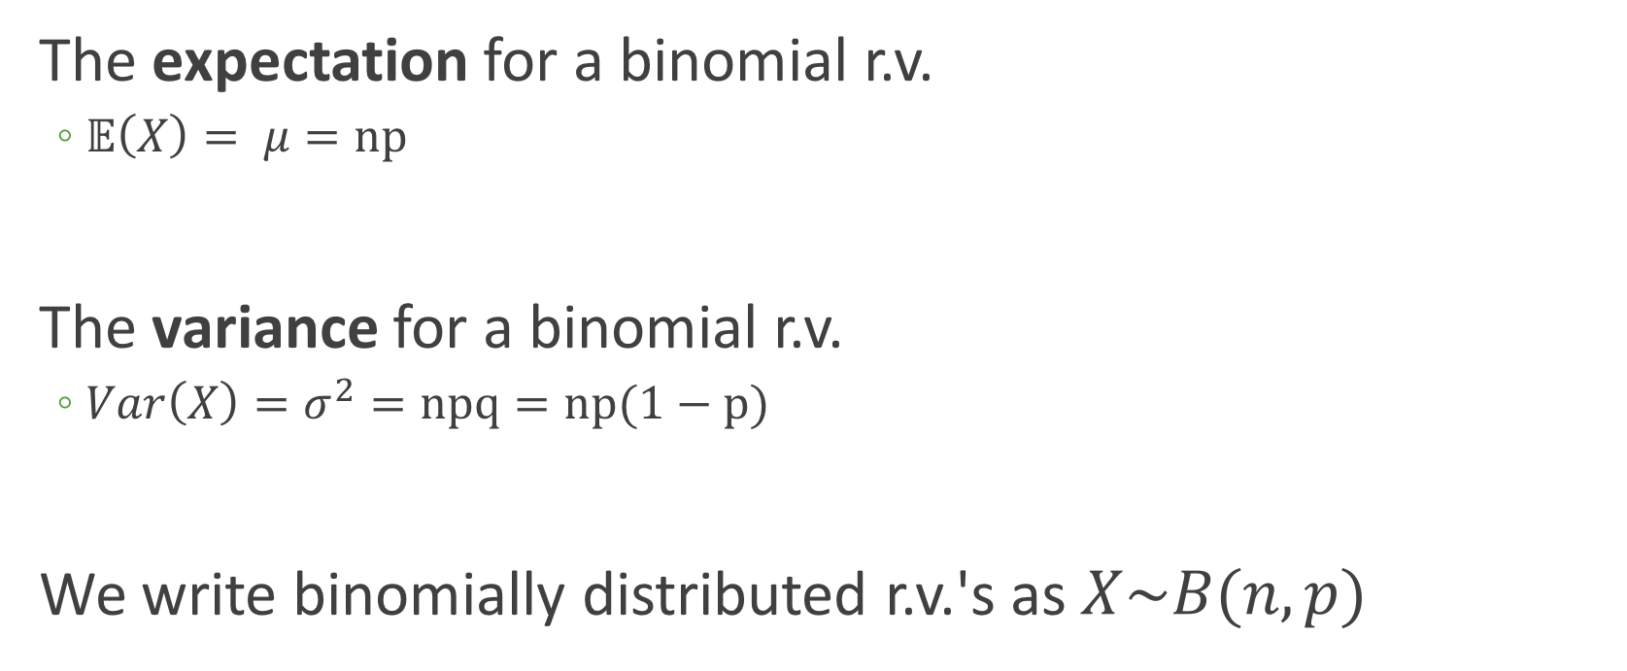
The binomial distribution
The expectation for a binomial r.v.
$𝔼\left(X\right)= μ=np$
The variance for a binomial r.v.
$Var\left(X\right)=σ^{2}=npq=np(1−p)$
We write binomially distributed r.v.'s as $X\sim B(n,p)$

Slide 32
Example: Playing with a binomial rv
Each child born to a particular set of parents has a 25% probability of having blood type O. Assume the parents had five children.
Here, n = 5 and p = 0.25, meaning we define Type O as "success", and not Type O as "failure". → X~B(5, 0.25)
Tasks:
Compute expectation and variance
Visualize PMF
Visualize CDF
Make some calculations…

Slide 33
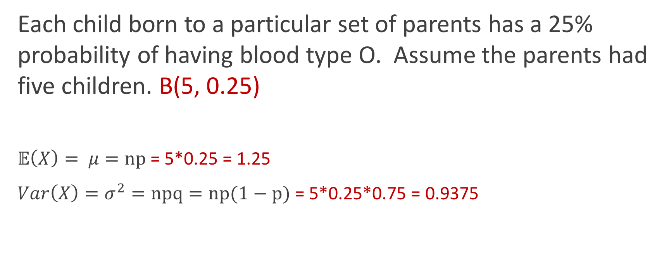
Expectation and variance
Each child born to a particular set of parents has a 25% probability of having blood type O. Assume the parents had five children. B(5, 0.25)
$𝔼\left(X\right)= μ=np$ = 5*0.25 = 1.25
$Var\left(X\right)=σ^{2}=npq=np(1−p)$ = 5*0.25*0.75 = 0.9375

Slide 34
Visualize the PMF

Slide 35
?distributions
Distributions in the stats package
Description:
Density, cumulative distribution function, quantile function and
random variate generation for many standard probability
distributions are available in the ‘stats’ package.
Details:
The functions for the density/mass function, cumulative
distribution function, quantile function and random variate
generation are named in the form ‘dxxx’, ‘pxxx’, ‘qxxx’ and ‘rxxx’
respectively.
For the beta distribution see ‘dbeta’.
For the binomial (including Bernoulli) distribution see ‘dbinom’.
For the Cauchy distribution see ‘dcauchy’.
For the chi-squared distribution see ‘dchisq’.

Slide 36
Distribution functions, generally
Function | Purpose | Binomial version
dxxx() | Probability distribution | dbinom(x, size, prob)
pxxx() | CDF | pbinom(q, size, prob)
rxxx() | Generate random numbers from given distribution | rbinom(n, size, prob)
qxxx() | Quantile: Inverse of pxxx() | qbinom(p, size, prob)

Slide 37
Binomial distribution functions
Binomial function | Example | Output
dbinom(x, size, prob) | dbinom(2, 5, 0.25) | Prob of obtaining 2 successes in 5 trials, where p=0.25 → 0.263
pbinom(q, size, prob) | pbinom(2, 5, 0.25) | Prob of obtaining ≤2 successes in 5 trials, where p=0.25 → 0.896
rbinom(n, size, prob) | rbinom(100, 5, 0.25) | Generate 100 k values from this binomial dist. → 100 from {0,1,2,3,4}
qbinom(p, size, prob) | qbinom(0.896, 5, 0.25) | Smallest value x where F(x) >= p* → 2 *not prob success, just a prob

Slide 38
Making the PMF
> ## Use dbinom() to get the PMF values
p = 0.25
n = 5
k0 <- dbinom(0, 5, 0.25) ## Prob of 0 successes, aka no children are Type O
k1 <- dbinom(1, 5, 0.25) ## Prob of 1 success, aka only 1 child is Type O
## Advanced:
library(purrr)
map_dbl(0:5, dbinom, 5, 0.25)
[1] 0.2373046875 0.3955078125 0.2636718750 0.0878906250 0.0146484375
[6] 0.0009765625

Slide 39
Making the PMF
## data frame (tibble) of probabilities for PMF
> data.pmf <- tibble(k = 0:5, prob = c(0.236623, 0.396, 0.264, 0.0879, 0.0145, 0.000977))
> data.pmf
# A tibble: 6 x 2
k prob
<int> <dbl>
1 0 0.236623
2 1 0.396000
3 2 0.264000
4 3 0.087900
5 4 0.014500
6 5 0.000977
## Equivalent
data.pmf <- tibble(k = 0:5, prob = map_dbl(0:5, dbinom, 5, 0.25))

Slide 40
Making the PMF uses a different *stat*
> ggplot(data.pmf, aes(x = k, y=prob))+ geom_bar( stat="identity" ) +
xlab("Number of kids") + ylab("Probability Type O")

Slide 41
Tweaking the x-axis
> ggplot(data.pmf, aes(x = k, y=prob))+ geom_bar( stat="identity" ) +
ylab("Probability Type O") +
scale_x_continuous(name = "Number of kids", breaks = 0:5)

Slide 42
Adding some text
> ggplot(data.pmf, aes(x = k, y=prob))+ geom_bar( stat="identity" ) +
ylab("Probability Type O") +
scale_x_continuous(name = "Number of kids", breaks = 0:5) +
geom_text(aes(x = k, y= prob + 0.01, label = prob))

Slide 43
Visualize the CDF
> binom.sample <- tibble(x = rbinom(1000, 5, 0.25))
> ggplot(binom.sample, aes(x=x)) + stat_ecdf() +
xlab("# Type O kids") + ylab("Cumulative probability")

Slide 44
Solving for probabilities
Each child born to a particular set of parents has a 25% probability of having blood type O. Assume the parents had five children. B(5, 0.25)
What is the probability that exactly 2 children were Type O?
> dbinom(2, 5, 0.25)
[1] 0.2636719

Slide 45
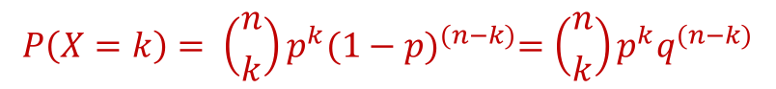
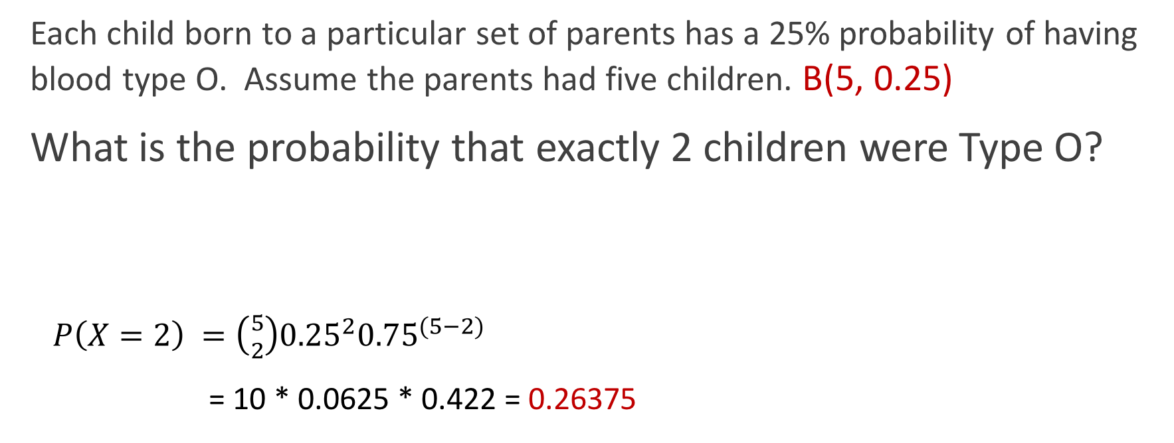
Solving for probabilities
Each child born to a particular set of parents has a 25% probability of having blood type O. Assume the parents had five children. B(5, 0.25)
What is the probability that exactly 2 children were Type O?
$P\left(X=2\right) =\left({5 \atop 2}\right){0.25}^{2}{0.75}^{(5−2)}$
= 10 * 0.0625 * 0.422 = 0.26375
$$P\left(X=k\right)= \left({n \atop k}\right)p^{k}{(1−p)}^{(n−k)}=\left({n \atop k}\right)p^{k}q^{(n−k)}$$

Slide 46
Solving for probabilities
B(5, 0.25)
What is the probability that 2 or fewer children were Type O?
> pbinom(2, 5, 0.25)
[1] 0.8964844

Slide 47
Solving for probabilities
B(5, 0.25)
What is the probability that 2 or fewer children were Type O?
> dbinom(0, 5, 0.25) + dbinom(1, 5, 0.25) + dbinom(2, 5, 0.25)
[1] 0.8964844

Slide 48
Solving for probabilities
B(5, 0.25)
What is the probability that more than 2 children (ie either 3, 4, or 5) were Type O?
> 1 - pbinom(2, 5, 0.25)
[1] 0.1035156

Slide 49
Solving for probabilities
B(5, 0.25)
What is the probability that more than 2 children (ie either 3, 4, or 5) were Type O?
> dbinom(3, 5, 0.25) + dbinom(4, 5, 0.25) + dbinom(5, 5, 0.25)
[1] 0.1035156

Slide 50
BREATHE

Slide 51
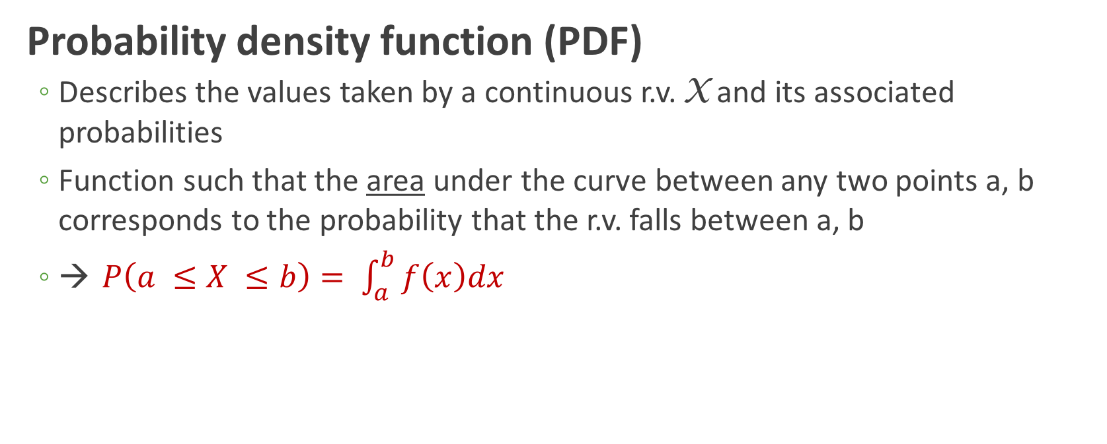
Expressing continuous random variables
Probability density function (PDF)
Describes the values taken by a continuous r.v. X and its associated probabilities
Function such that the area under the curve between any two points a, b corresponds to the probability that the r.v. falls between a, b
→ $P\left(a ≤X ≤b\right)= \int_{a}^{b}{f\left(x\right)dx}$

Slide 52
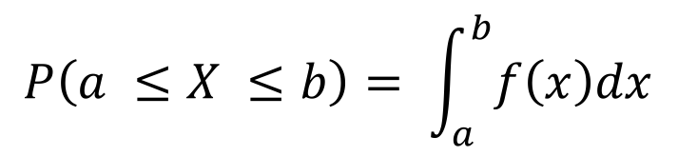
PDF
$$P\left(a ≤X ≤b\right)= \int_{a}^{b}{f\left(x\right)dx}$$

Slide 53
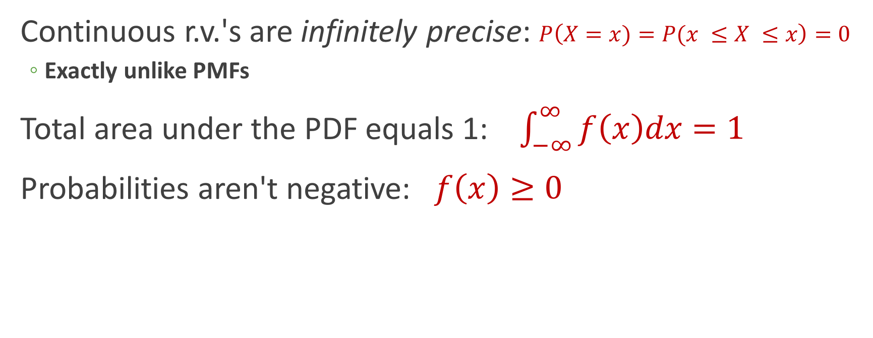
PDF properties
Continuous r.v.'s are infinitely precise: $P\left(X=x)=P(x ≤X ≤x\right)=0$
Exactly unlike PMFs
Total area under the PDF equals 1: $\int_{−∞}^{∞}{f\left(x\right)dx=1}$
Probabilities aren't negative: $f\left(x\right)≥0$

Slide 54
Expressing continuous random variables
Cumulative distribution function (CDF)
Function defined, for a specific value x of a continuous r.v. X, as F(x) = P(X ≤ x)
(mostly) the same as for discrete

Slide 55
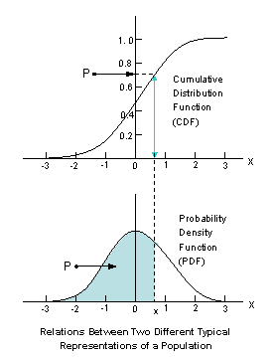
Relationship between PDF and CDF

Slide 56
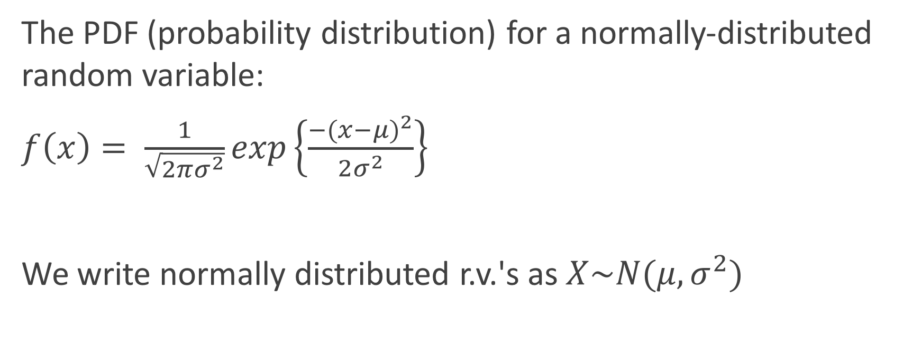
Jumping right in: Normal distribution
The PDF (probability distribution) for a normally-distributed random variable:
$f\left(x\right)= \frac{1}{\sqrt{2πσ^{2}}}exp\left\{\frac{{−(x−μ)}^{2}}{2σ^{2}}\right\}$
We write normally distributed r.v.'s as $X\sim N(μ, σ^{2})$
It's gross, everyone knows it, and you will be neither plugging nor chugging with this equation

Slide 57
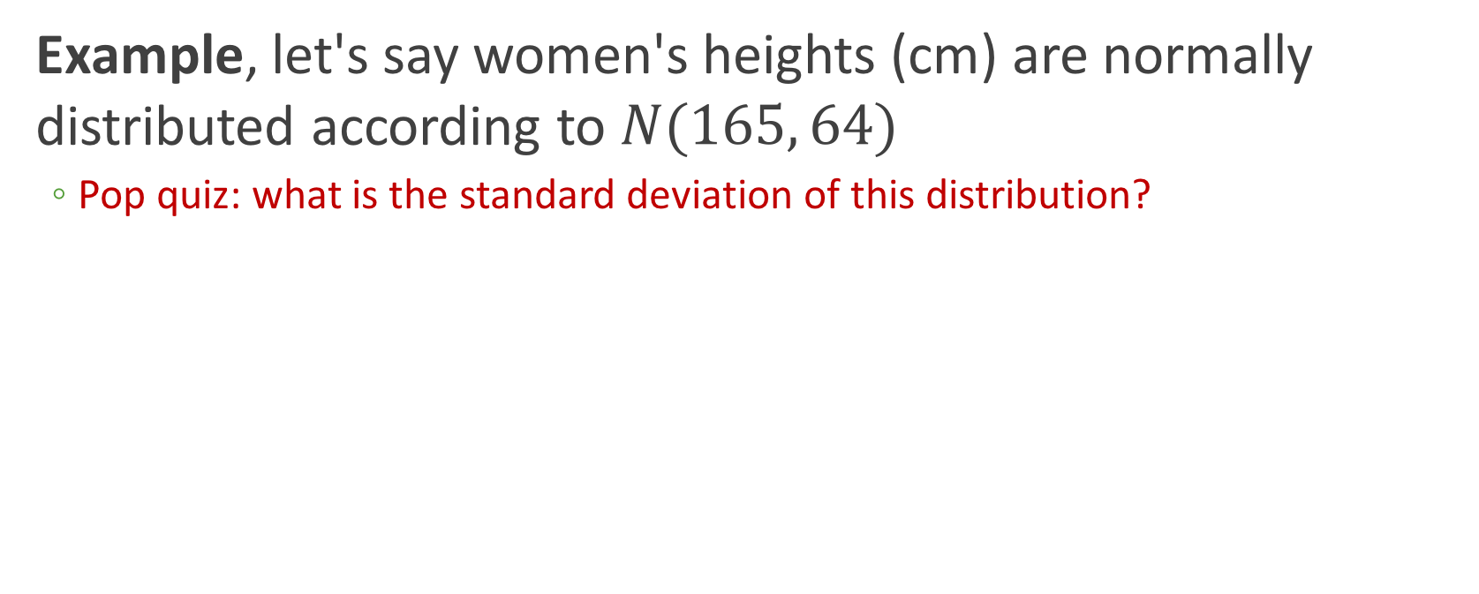
PDF of normal distribution
Example, let's say women's heights (cm) are normally distributed according to $N(165, 64)$
Pop quiz: what is the standard deviation of this distribution?

Slide 58
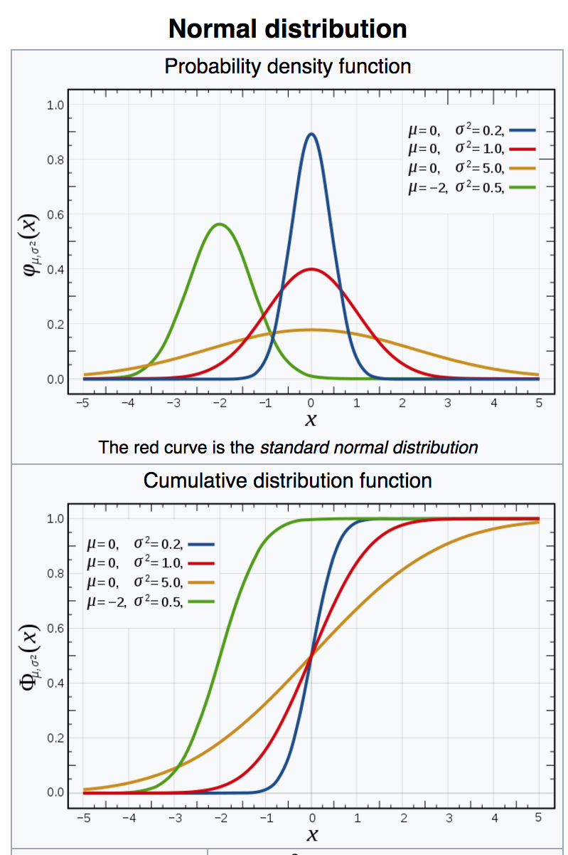
Wikipedia weighs in

Slide 59
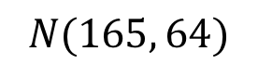
Making the PDF
Another "interesting" hack:
> plot.range <- tibble(x = c(165 - 32, 165 + 32))
> ggplot(plot.range, aes(x=x)) +
stat_function(fun = dnorm, args=list(mean=164, sd=8))
$$N(165, 64)$$

Slide 60
Making the CDF
> data.cdf <- tibble(x = rnorm(10000, 164, 8))
> ggplot(data.cdf, aes(x=x)) + stat_ecdf()

Slide 61
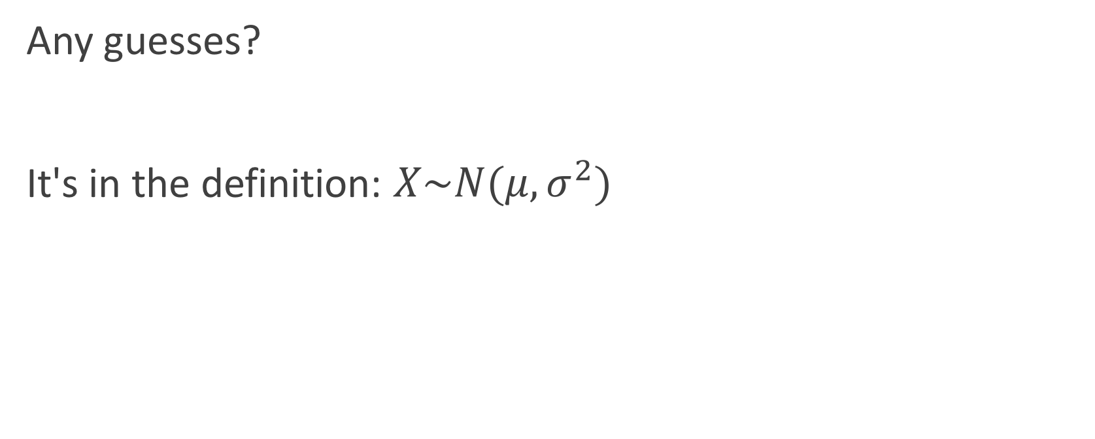
Expectation and variance
Any guesses?
It's in the definition: $X\sim N(μ, σ^{2})$

Slide 62
Working with the normal distribution
Types of questions one can ask:
What is the probability that a randomly-chosen woman is taller than 158 cm?
What is the probability that a randomly-chosen woman is between 163—170 cm tall?
What is the probability that a randomly-chosen woman is shorter than 167 cm?
What is the probability that a randomly-chosen woman is 168 cm tall?

Slide 63
Working with the normal distribution
Types of questions one can ask:
What is the probability that a randomly-chosen woman is taller than 158 cm?
What is the probability that a randomly-chosen woman is between 163—170 cm tall?
What is the probability that a randomly-chosen woman is shorter than 167 cm?
What is the probability that a randomly-chosen woman is 168 cm tall?

Slide 64
Properties of the normal distribution
Symmetric around the mean
Mean = median = mode
Inflection points

Slide 65
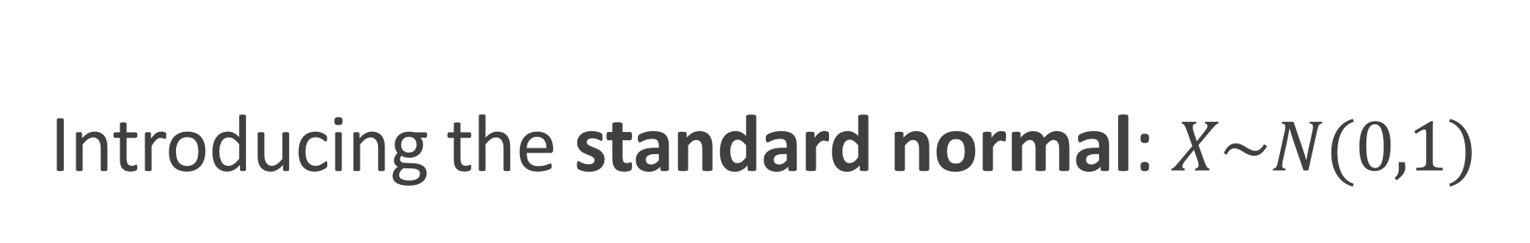
Introducing the standard normal: $X\sim N(0,1)$
𝜇 = 0
σ = 1
These are Z-scores

Slide 66

Standard Normal $X\sim N(0,1)$

Slide 67

PDF and CDF of $X\sim N(0,1)$
If the shaded grey area = 0.977, what is x?

Slide 68
Standard Normal $X\sim N(0,1)$
Due to symmetry, P(X ≤ -x) = 1 - P(X ≤ x)

Slide 69
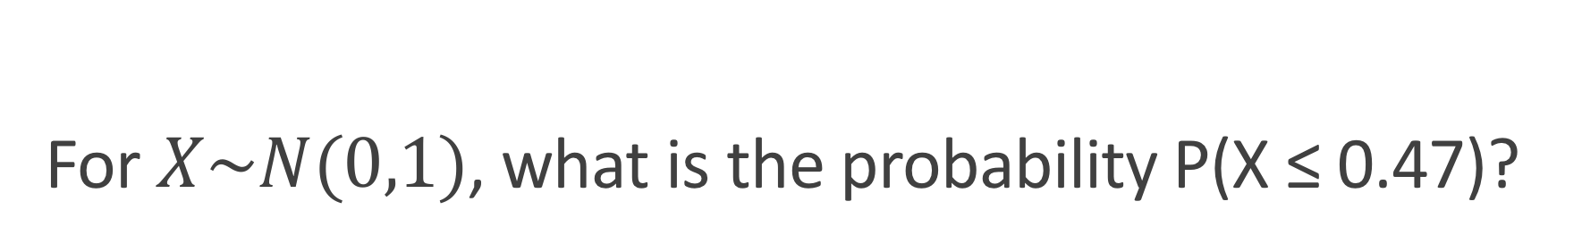
For $X\sim N(0,1)$, what is the probability P(X ≤ 0.47)?
# CDF: P(X <= 0.47)
> pnorm(0.47)
[1] 0.6808225

Slide 70
Normal distribution functions
Normal function | Meaning
dnorm(x) | Density at X=x
pnorm(q) | P(X <= x)
rnorm(n) | Generate n random draws from N(0,1)
qnorm(p) | Obtain x from given CDF area: qnorm(0.6808225) = 0.47

Slide 71
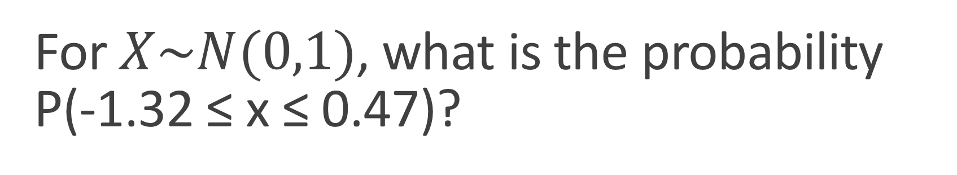
For $X\sim N(0,1)$, what is the probability P(-1.32 ≤ x ≤ 0.47)?

Slide 72
For $X\sim N(0,1)$, what is the probability P(-1.32 ≤ x ≤ 0.47)?
=
-
# P(X <= 0.47)
> pnorm(0.47)
[1] 0.6808225
# P(X <= -1.32)
> pnorm(-1.32)
[1] 0.09341751
0.587405

Slide 73
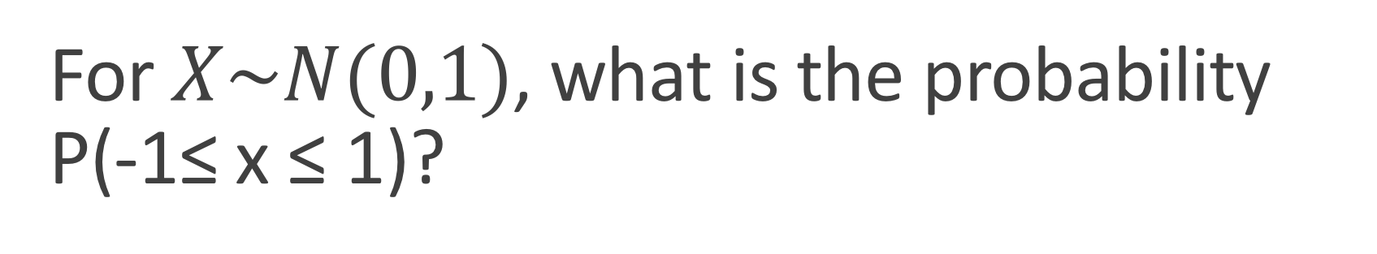
For $X\sim N(0,1)$, what is the probability P(-1≤ x ≤ 1)?
AKA probability of being within 1 standard deviation of mean?
~0.68

Slide 74
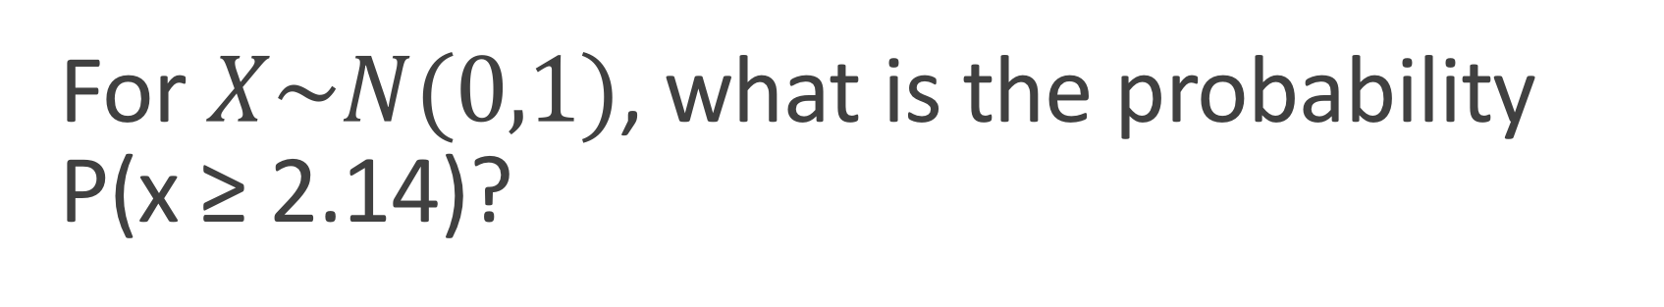
For $X\sim N(0,1)$, what is the probability P(x ≥ 2.14)?
## Two approaches:
> 1 - pnorm(2.14)
[1] 0.01617738
> pnorm(-2.14)
[1] 0.01617738

Slide 75
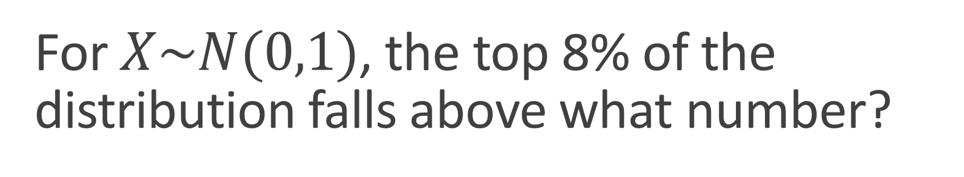
For $X\sim N(0,1)$, the top 8% of the distribution falls above what number?
> qnorm(1 - 0.08)
[1] 1.405072
> -1 * qnorm(0.08)
[1] 1.405072
Area=0.08
???

Slide 76
Historical consideration of z-scores

Slide 77
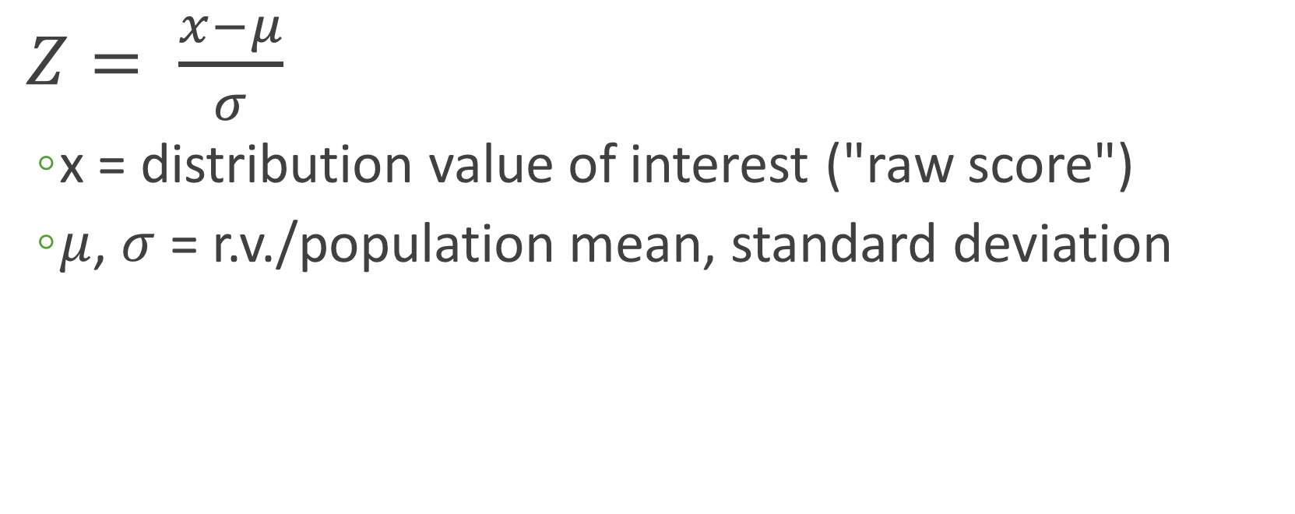
Re-scaling to standard normal to compare distributions
$Z= \frac{x−μ}{σ}$
x = distribution value of interest ("raw score")
$μ$, $σ$ = r.v./population mean, standard deviation

Slide 78
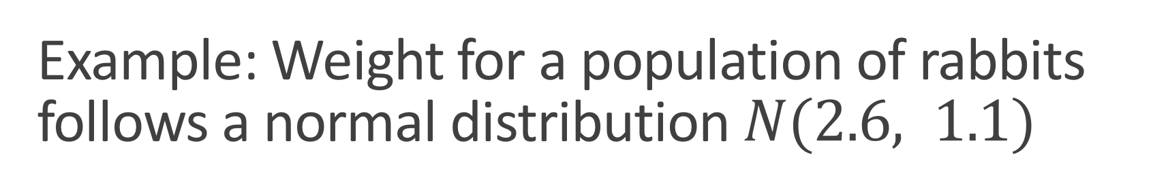
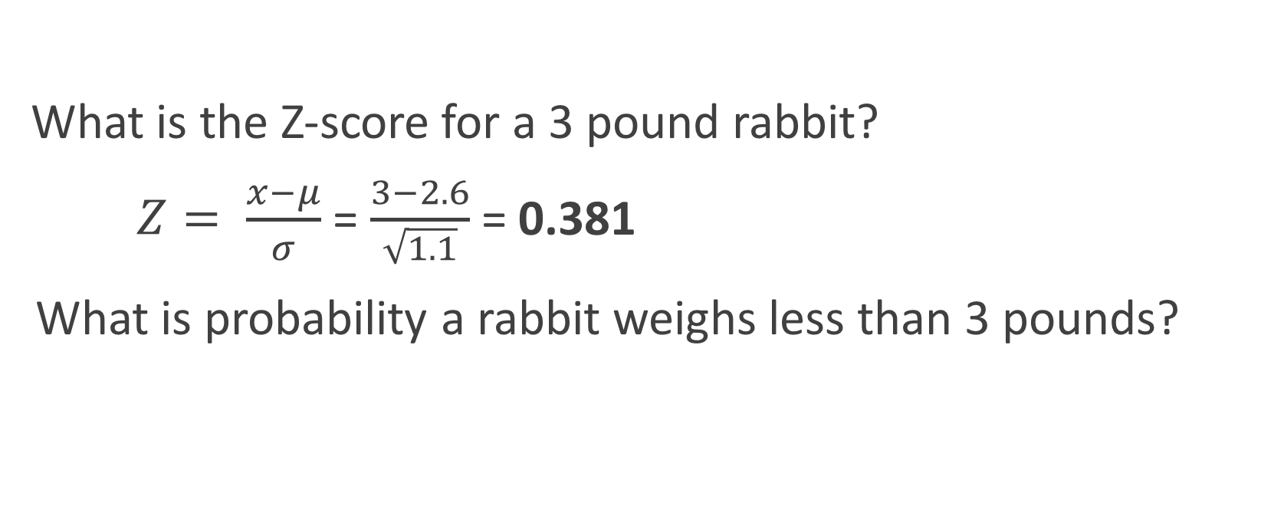
Example: Weight for a population of rabbits follows a normal distribution $N(2.6, 1.1)$
What is the Z-score for a 3 pound rabbit?
$Z= \frac{x−μ}{σ}$ = $\frac{3−2.6}{\sqrt{1.1}}$ = 0.381
What is probability a rabbit weighs less than 3 pounds?
Does is make sense that this number is positive?
pnorm(0.381) = 0.648
pnorm(3, 2.6, sqrt(1.1)) = 0.648
THE FUTURE IS NOW

Slide 79
Normal distributions functions, revisited
All functions assume standard normal. Provide additional arguments for other normals:
Standard normal | Any normal
pnorm(q) = pnorm(q, 0, 1) | pnorm(q, mean, sd)

Slide 80
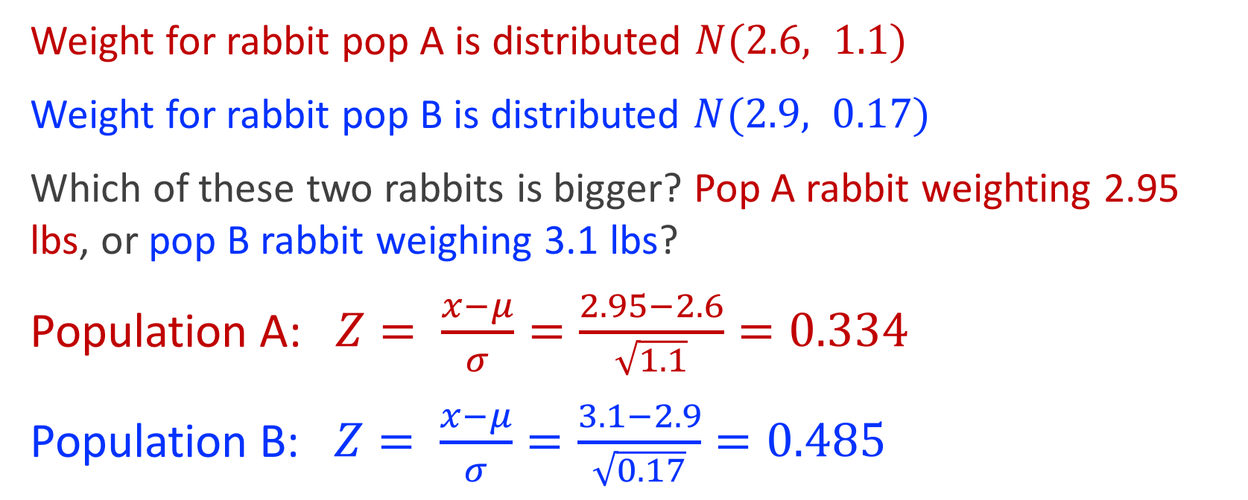
Z-scores are most useful for comparing different distributions
Weight for rabbit pop A is distributed $N(2.6, 1.1)$
Weight for rabbit pop B is distributed $N(2.9, 0.17)$
Which of these two rabbits is bigger? Pop A rabbit weighting 2.95 lbs, or pop B rabbit weighing 3.1 lbs?
Population A: $Z= \frac{x−μ}{σ}=\frac{2.95−2.6}{\sqrt{1.1}}=0.334$
Population B: $Z= \frac{x−μ}{σ}=\frac{3.1−2.9}{\sqrt{0.17}}=0.485$

Slide 81
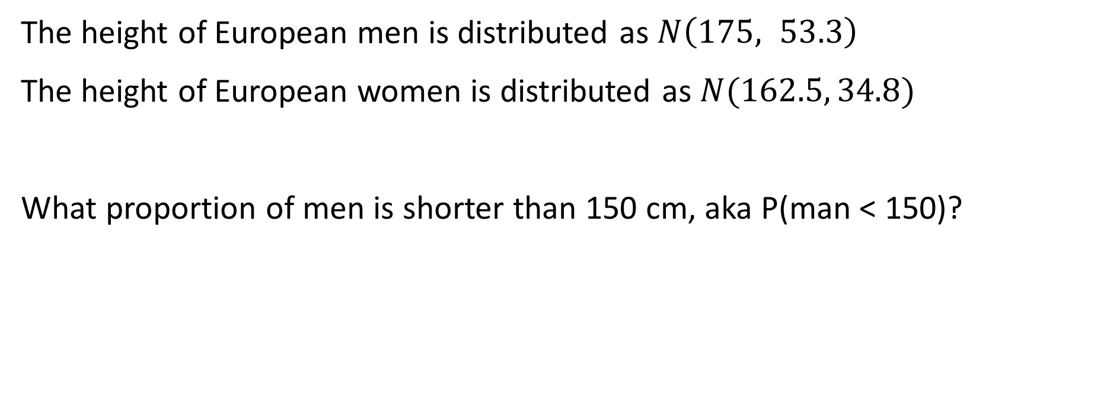
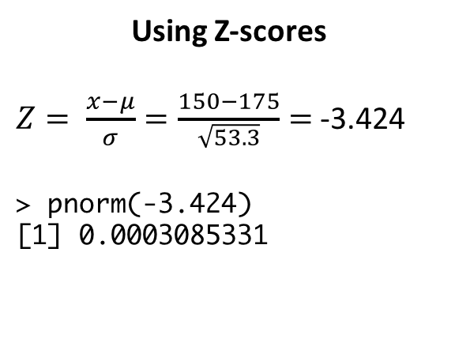
Putting it all together
The height of European men is distributed as $N\left(175, 53.3\right)$
The height of European women is distributed as $N(162.5, 34.8)$
What proportion of men is shorter than 150 cm, aka P(man < 150)?
Using Z-scores
$Z= \frac{x−μ}{σ}=\frac{150−175}{\sqrt{53.3}}=$ -3.424
> pnorm(-3.424)
[1] 0.0003085331
Skipping Z-scores
> pnorm(150, 175, sqrt(53.3))
[1] 0.0003081516
Notes:
5331

Slide 82
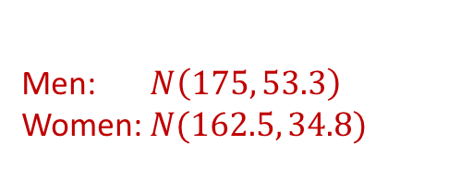
Putting it all together
Men: $N\left(175, 53.3\right)$
Women: $N(162.5, 34.8)$
What proportion of women is taller than 162.5 cm?
50%
Notes:
5331

Slide 83
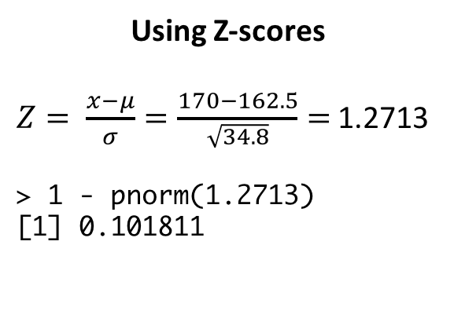
Putting it all together
Men: $N\left(175, 53.3\right)$
Women: $N(162.5, 34.8)$
What proportion of women is taller than 170 cm?
Using Z-scores
$Z= \frac{x−μ}{σ}=\frac{170−162.5}{\sqrt{34.8}}=$ 1.2713
> 1 - pnorm(1.2713)
[1] 0.101811
Skipping Z-scores
> 1 - pnorm(170, 162.5, sqrt(34.8))
[1] 0.1017987
Notes:
5331

Slide 84
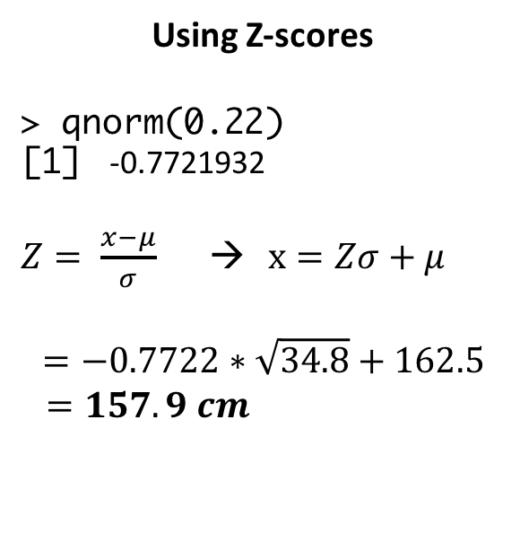
Putting it all together
Men: $N\left(175, 53.3\right)$
Women: $N(162.5, 34.8)$
What is the tallest a woman can be and still be in the bottom 22%?
Using Z-scores
> qnorm(0.22)
[1] -0.7721932
$Z= \frac{x−μ}{σ}$ → $x=Zσ+μ$
$$=−0.7722∗\sqrt{34.8}+162.5$$
$=157.9 cm$
Skipping Z-scores
> qnorm(0.22, 162.5, sqrt(34.8))
[1] 157.9447
Notes:
5331

Slide 85
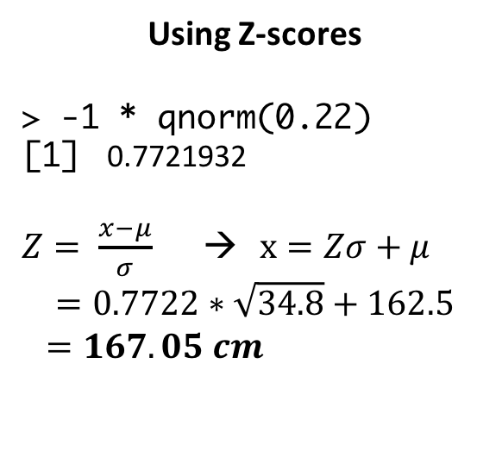
Putting it all together
Men: $N\left(175, 53.3\right)$
Women: $N(162.5, 34.8)$
What is the shortest a woman can be and still be in the top 22%?
Using Z-scores
> -1 * qnorm(0.22)
[1] 0.7721932
$Z= \frac{x−μ}{σ}$ → $x=Zσ+μ$
$$=0.7722∗\sqrt{34.8}+162.5$$
$=167.05 cm$
Skipping Z-scores
> qnorm(1-0.22, 162.5, sqrt(34.8))
[1] 167.0553
Notes:
5331

Slide 86
Putting it all together
Men: $N\left(175, 53.3\right)$
Women: $N(162.5, 34.8)$
What is the probability a randomly chosen man is between 175–182 cm tall?
→ P(X<182) – P(X<175) = P(X<182) – 0.5
> pnorm(182, 175, sqrt(53.3)) – 0.5
[1] 0.3311738
Notes:
5331

Slide 87
Putting it all together
Men: $N\left(175, 53.3\right)$
Women: $N(162.5, 34.8)$
What is the probability a randomly chosen man is either between 175–182 cm tall or between 150—160 cm tall?
→ P(175 < X < 182) + P(150 < X < 160)
### First probability
> pnorm(182, 175, sqrt(53.3)) – 0.5
[1] 0.3311738
> ### Second prob.
> pnorm(160, 175, sqrt(53.3)) – pnorm(150, 175, sqrt(53.3))
[1] 0.01965059
> 0.3311738 + 0.01965059
[1] 0.3508244
Notes:
5331

Slide 88
Putting it all together
Men: $N\left(175, 53.3\right)$
Women: $N(162.5, 34.8)$
I have two randomly-chosen European friends, one man and one woman each. What is the probability the man is at least 180 cm and the woman is between 163—170 cm?
→ P(man > 180) x P(163 < woman < 170)
### First probability
> 1 - pnorm(180, 175, sqrt(53.3))
[1] 0.2467138
> ### Second prob.
> pnorm(170, 162.5, sqrt(34.8)) – pnorm(163, 162.5, sqrt(34.8))
[1] 0.3644282
> 0.246713*0.3644282
[1] 0.08990917
Notes:
5331

Slide 89
Putting it all together
Men: $N\left(175, 53.3\right)$
Women: $N(162.5, 34.8)$
I have two new randomly-chosen European friends, one man and one woman each. What is the probability the man is 180 cm and the woman is 163 cm?
→ P(man = 180) x P(woman = 163)
→ 0
Notes:
5331

Slide 90
Putting it all together
Men: $N\left(175, 53.3\right)$
Women: $N(162.5, 34.8)$
Assume 50.8% of Europeans are women. If a randomly-chosen person is shorter than 155 cm tall, what is the probability the person is a woman?
→ P(woman | < 155) =
P(<155 | woman) * P(woman) / P(<155)
0.102
0.508
### P(<155 | woman)
> pnorm(155, 162.5, sqrt(34.8))
[1] 0.1017987
Notes:
5331

Slide 91
Solving the denominator
P(<155) = P(<155 and man) + P(<155 and woman) =
P(<155|man)*P(man) + P(<155|woman)*P(woman)
0.0031
0.492
0.102
0.508
### P(<155 | man)
> pnorm(155, 175, sqrt(53.3))
[1] 0.003076926
= 0.0533

Slide 92
Putting it all together
Men: $N\left(175, 53.3\right)$
Women: $N(162.5, 34.8)$
Assume 50.8% of Europeans are women. If a randomly-chosen person is shorter than 155 cm, what is the probability the person is a woman?
→ P(woman | < 155) =
P(<155 | woman) * P(woman) / P(<155)
0.102
0.508
0.533
= 0.972
Notes:
5331

Slide 93
BREAK

Slide 94
Statistical inference

Slide 95
Two main flavors of statistical inference
Estimation
Estimate a population parameter from sample data
Point estimates: What is the population mean?
Interval estimates: In what range of values is the population mean likely to fall?
Hypothesis testing
Test whether the value of a population parameter is equal to some specific value
Is there evidence that my sample differs from some underlying population?

Slide 96
The sampling distribution
The probability distribution of values for an estimate that we obtain under sampling

Slide 97
Obtaining a sampling distribution
> genes <- read.csv("genes.csv")
> head(genes)
nucleotides
1 3785
2 7416
3 2135
4 7682
5 5766
6 11079
> mean(genes$nucleotides)
[1] 2761.039
> sd(genes$nucleotides)
[1] 2037.645
> ggplot(genes, aes(x=nucleotides)) + geom_histogram(fill="white", color="black")

Slide 98
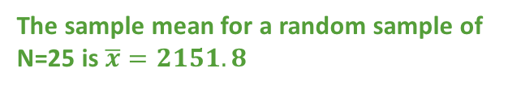
Obtaining a sampling distribution
### the function sample_n draws a random sample of rows
> small.sample <- genes %>% sample_n(25)
> mean(small.sample$nucleotides)
[1] 2151.8
> ggplot(small.sample , aes(x = nucleotides)) + geom_histogram() +
geom_vline(xintercept=2151.8, color="blue") +
geom_vline(xintercept= 2761.039, color="red")
The sample mean for a random sample of N=25 is $\overline{x}=2151.8$
geom_vline(xintercept=…)
geom_hline(yintercept=…)
geom_abline(yintercept=…, slope=…)

Slide 99
Obtaining a sampling distribution
Now imagine we draw 20 samples of N=25 and compute each of their means:
Sampling distribution of the mean
> head(n20.means)
sample.mean
1 2584.84
2 2574.12
3 2382.64
4 3143.68
5 2252.56
6 2368.44

Slide 100
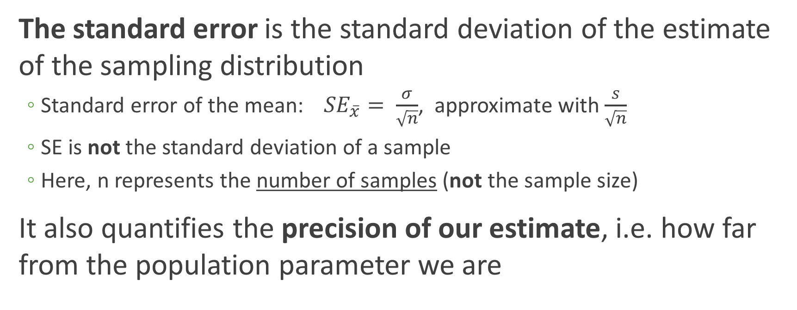
Quantifying the sampling distribution
The standard error is the standard deviation of the estimate of the sampling distribution
Standard error of the mean:${SE}_{\overline{x}}= \frac{σ}{\sqrt{n}}$, approximate with$\frac{s}{\sqrt{n}}$
SE is not the standard deviation of a sample
Here, n represents the number of samples (not the sample size)
It also quantifies the precision of our estimate, i.e. how far from the population parameter we are

Slide 101
Computing the standard error of the mean
> head(n20.means)
sample.mean
1 2584.84
2 2574.12
3 2382.64
4 3143.68
5 2252.56
6 2368.44
> sd(n20.means$sample.mean) / sqrt(20)
[1] 93.11888
Sampling distribution of the mean

Slide 102
Several sampling distributions comprised of N samples, each of n=25
N=20
N=50
N=100
N=1000
N=10000

Slide 103
Standard error decreases as N increases
N=20
N=50
N=100
N=1000
N=10000
SE = 93.1
SE = 58.1
SE = 37.9
SE = 13.3
SE = 4.02

Slide 104
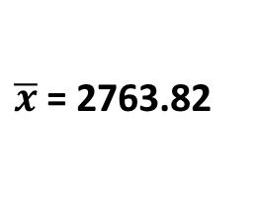
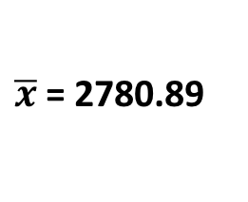
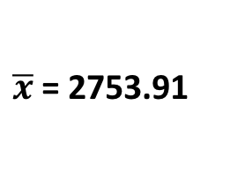
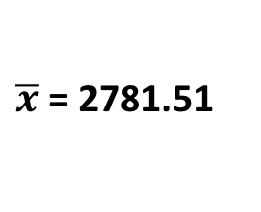
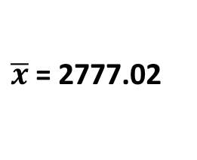
Therefore, mean of sampling distribution approaches population mean 2761.039
N=20
N=50
N=100
N=1000
N=10000
SE = 93.1
SE = 58.1
SE = 37.9
SE = 13.3
SE = 4.02
$\overline{x}$= 2780.89
$\overline{x}$= 2753.91
$\overline{x}$= 2781.51
$\overline{x}$= 2777.02
$\overline{x}$= 2763.82

Slide 105
The Central Limit Theorem
As sample size increases, the sampling distribution of the mean will be approximately normal regardless of true population distribution
Population distribution
N=1e4 sampling distribution

Slide 106
Next week..
Introduction to hypothesis testing and comparing means
More fun facts on estimation will come later in the semester, to be bundled with *likelihood*

